Slide 1
Look at sources of variability identifiable from the data
Statistical models incl flexible things like random forest to identify most important variables recorded empirically
Limited by what is actually recorded and the quality of measurement for the data

Slide 2
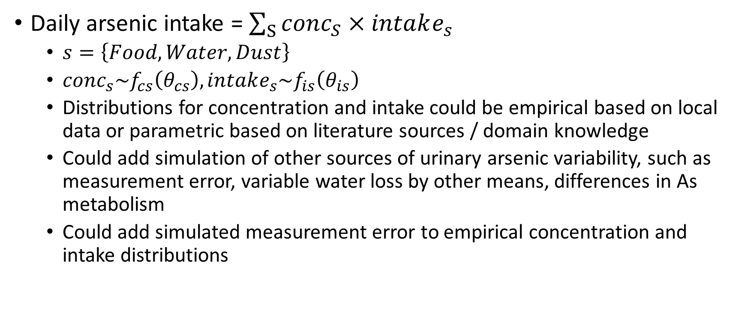
Look at plausible sources of variability including both data and unrecorded variables
Daily arsenic intake = $\sum_{S}{conc_{S}×intake_{s}}$
$s=\left\{Food, Water, Dust\right\}$
$conc_{s}\sim f_{cs}\left(θ_{cs}\right), intake_{s}\sim f_{is}\left(θ_{is}\right)$
Distributions for concentration and intake could be empirical based on local data or parametric based on literature sources / domain knowledge
Could add simulation of other sources of urinary arsenic variability, such as measurement error, variable water loss by other means, differences in As metabolism
Could add simulated measurement error to empirical concentration and intake distributions

Slide 3
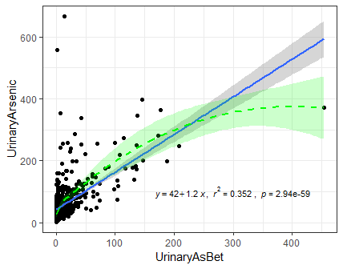
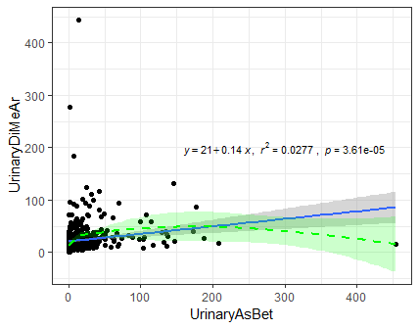
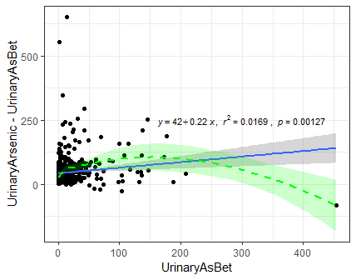
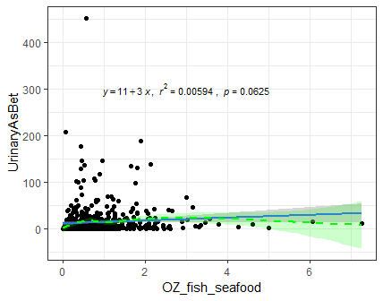
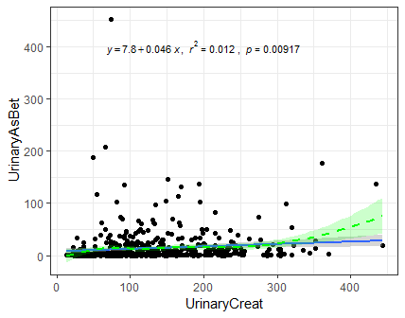

Slide 4
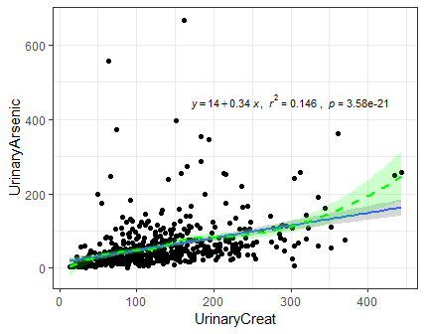
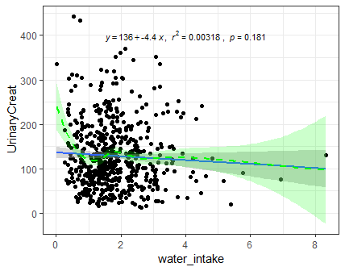

Slide 5
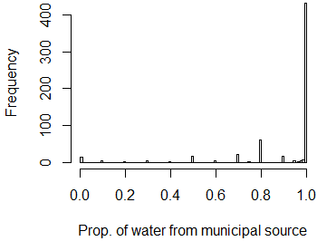

Slide 6
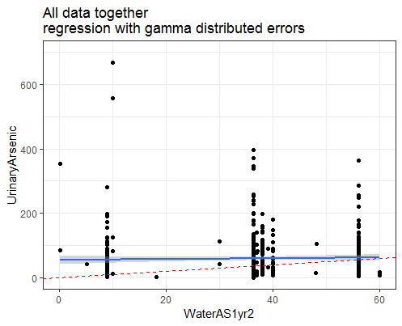
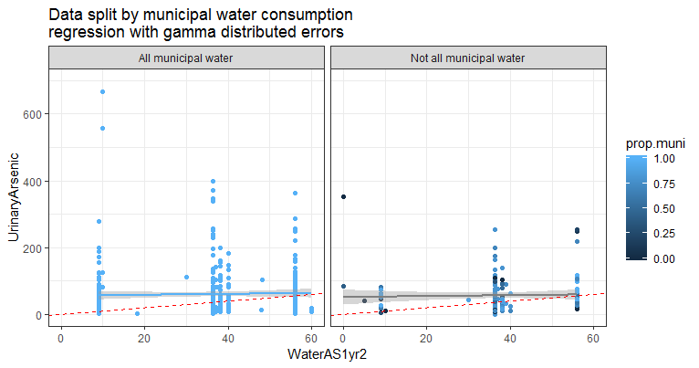
Linear regressions among all data, all data with 100% municipal water, data with <100% municipal water

Slide 7
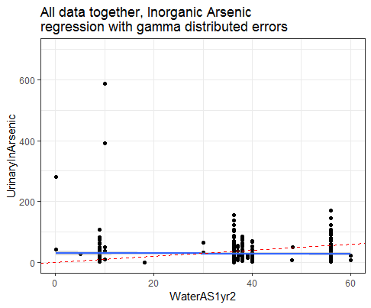
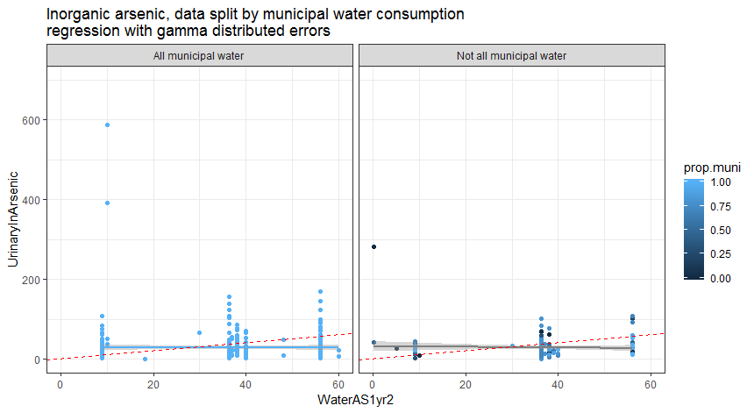
Linear regressions among all data, all data with 100% municipal water, data with <100% municipal water, inorganic arsenic

Slide 8
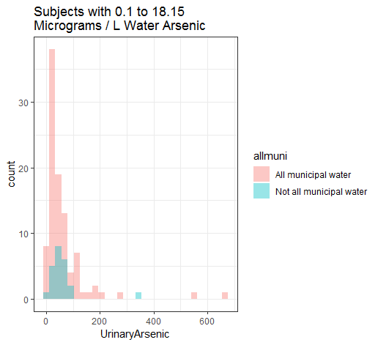
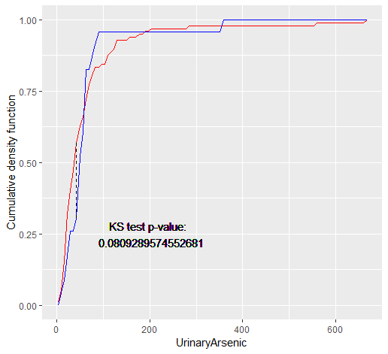
Do municipal and other source drinkers have different outcome distributions in each bin of drinking water arsenic?

Slide 9
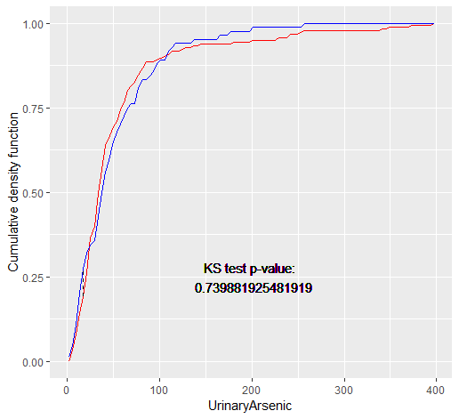
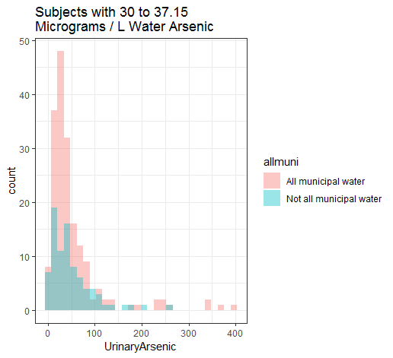
Do municipal and other source drinkers have different outcome distributions in each bin of drinking water arsenic?

Slide 10
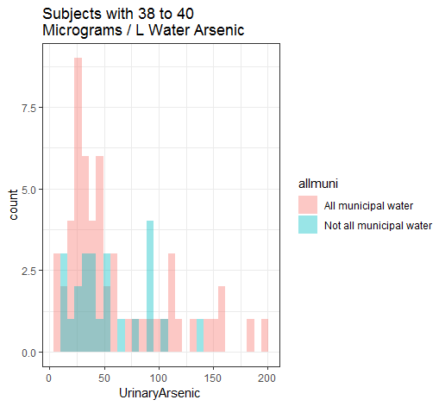
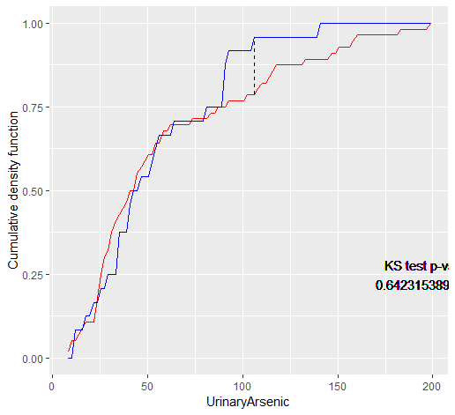
Do municipal and other source drinkers have different outcome distributions in each bin of drinking water arsenic?

Slide 11
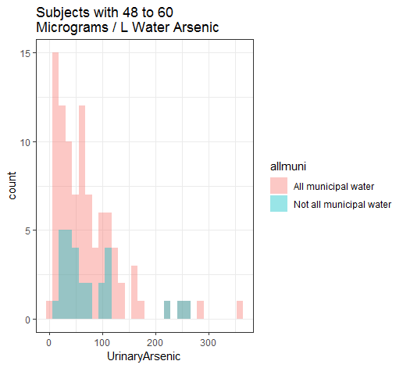
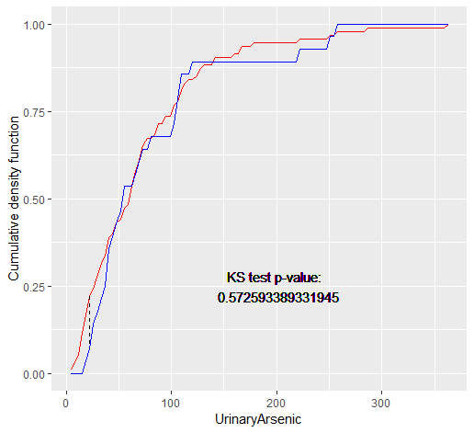
Do municipal and other source drinkers have different outcome distributions in each bin of drinking water arsenic?

Slide 12
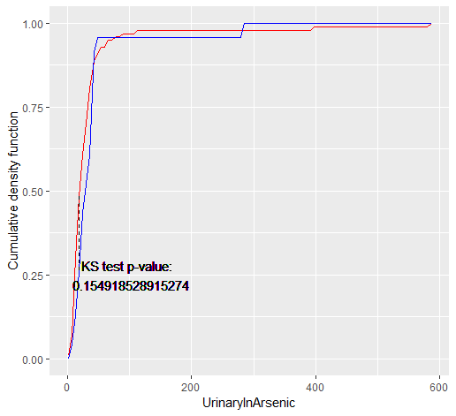
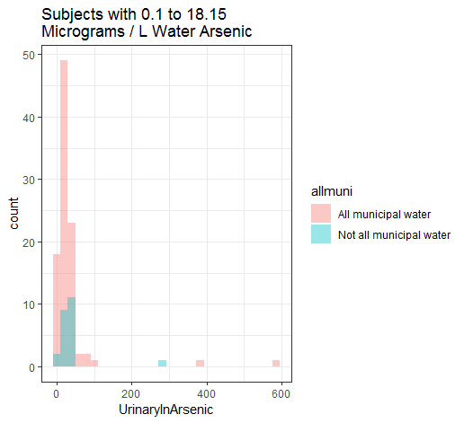
Do municipal and other source drinkers have different outcome distributions in each bin of drinking water arsenic?

Slide 13
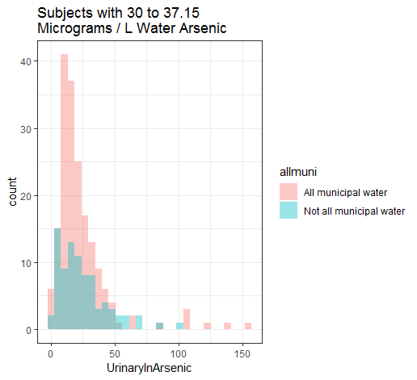
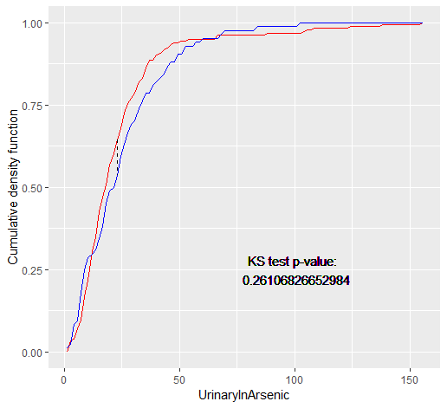
Do municipal and other source drinkers have different outcome distributions in each bin of drinking water arsenic?

Slide 14
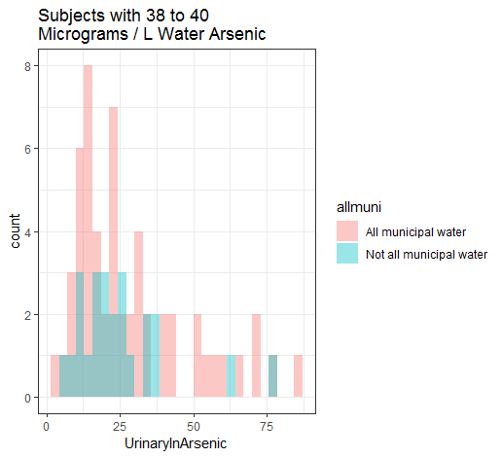
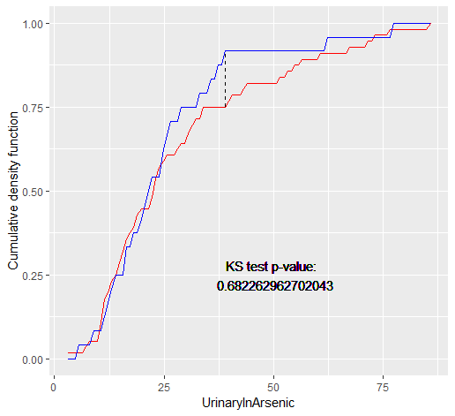
Do municipal and other source drinkers have different outcome distributions in each bin of drinking water arsenic?

Slide 15
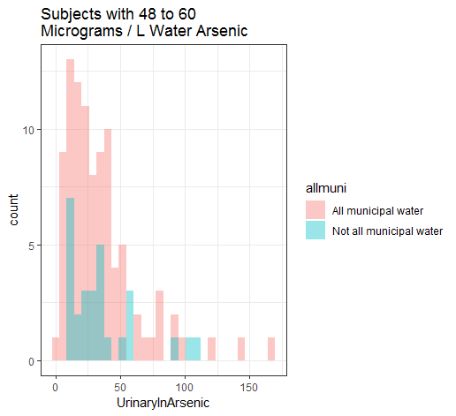

Do municipal and other source drinkers have different outcome distributions in each bin of drinking water arsenic?

Slide 16
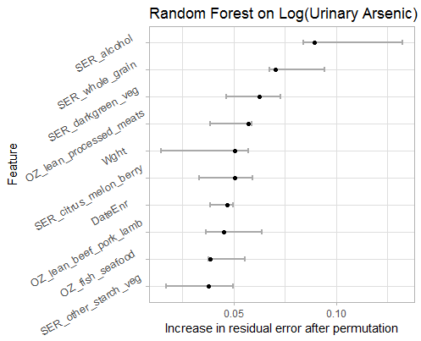
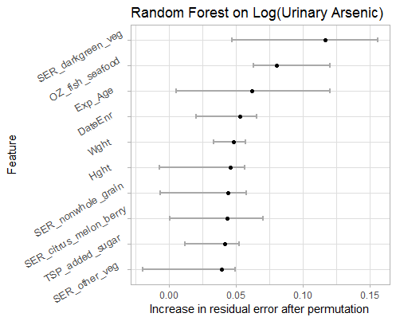
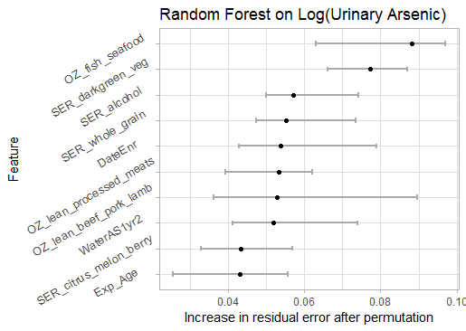
RF among all data, all data with 100% municipal water, data with <100% municipal water
Data subset | MSE (log scale) | Variance explained (log scale)
All (558) | 0.79 | 4.97%
100% municipal water (413) | 0.79 | 6.32%
<100% municipal water (145) | 0.84 | -4.32%

Slide 17
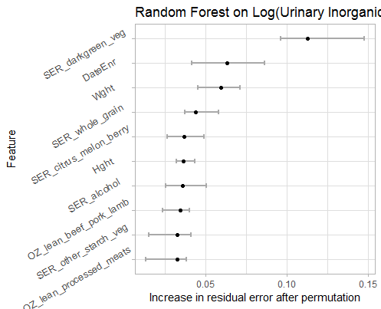
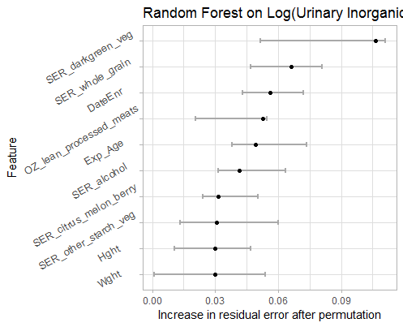
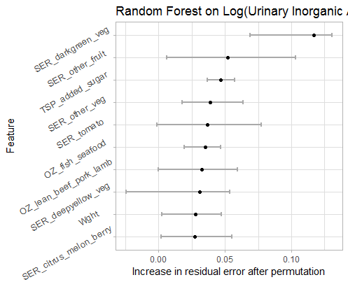
RF among all data, all data with 100% municipal water, data with <100% municipal water, InAS as outcome
Data subset | MSE (log scale) | Variance explained (log scale)
All (558) | 0.63 | 4.71%
100% municipal water (413) | 0.64 | 3.67%
<100% municipal water (145) | 0.69 | -3.61%

Slide 18
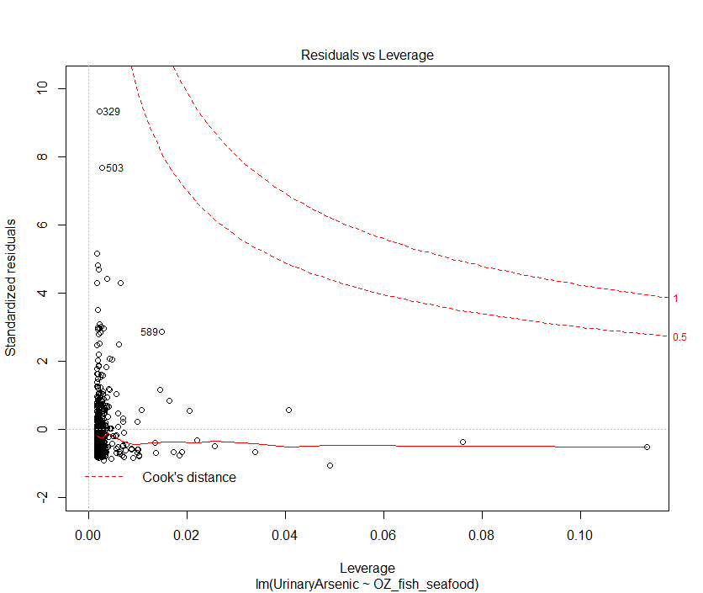
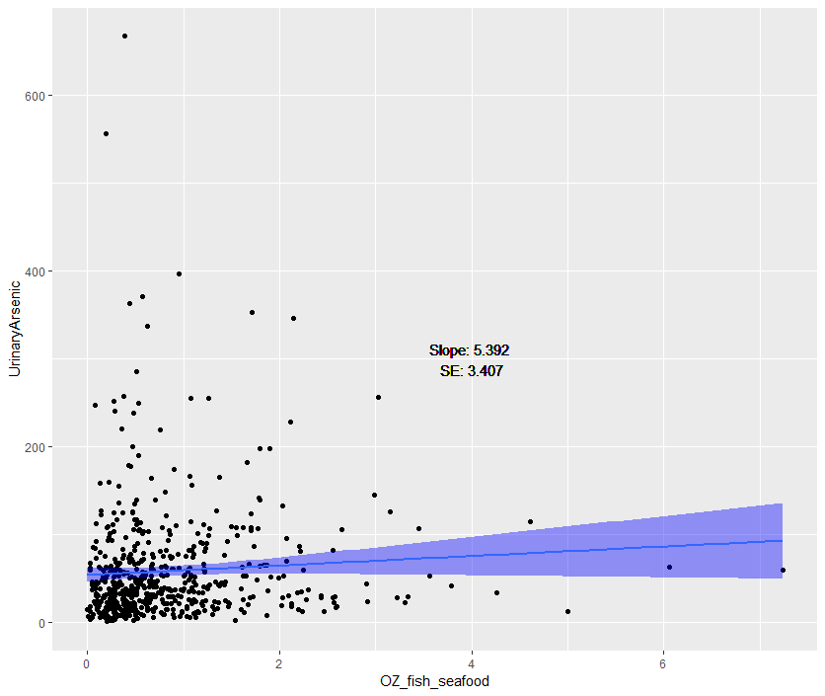
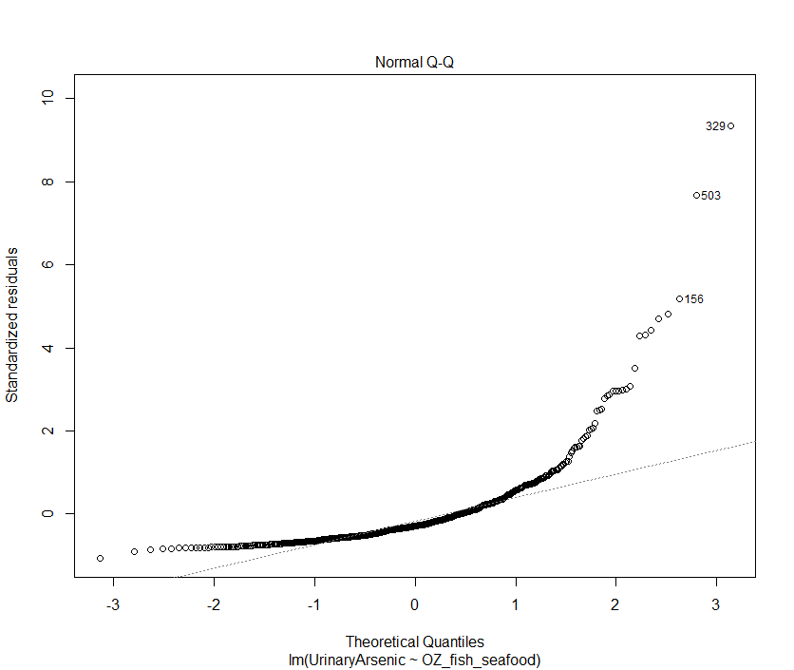
Seafood vs. arsenic linear regression

Slide 19
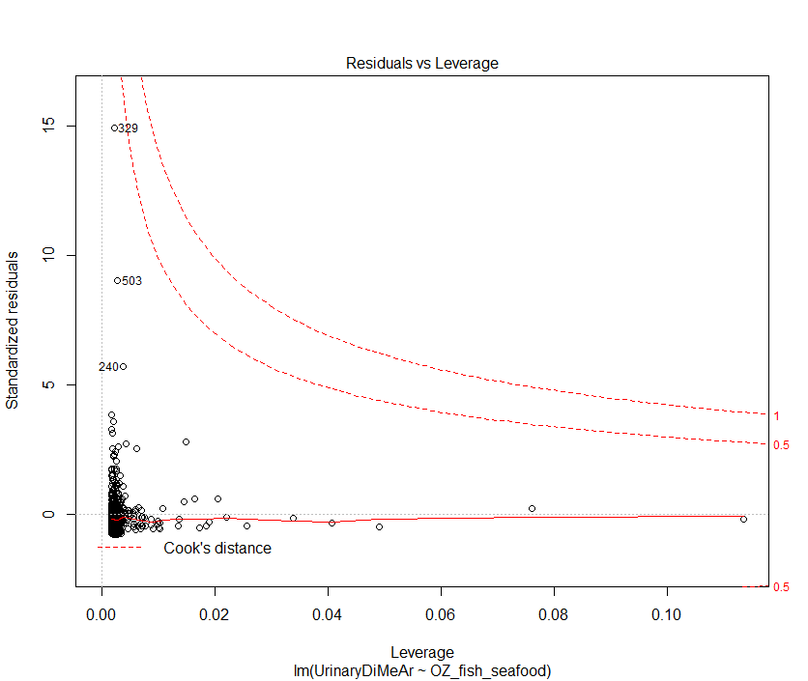
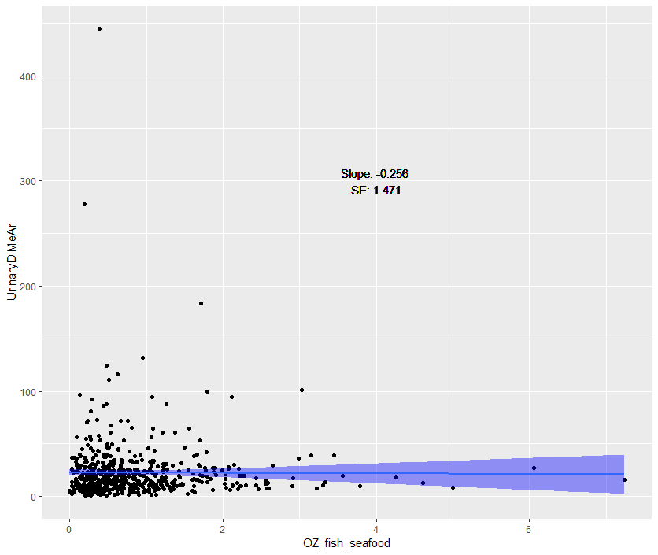
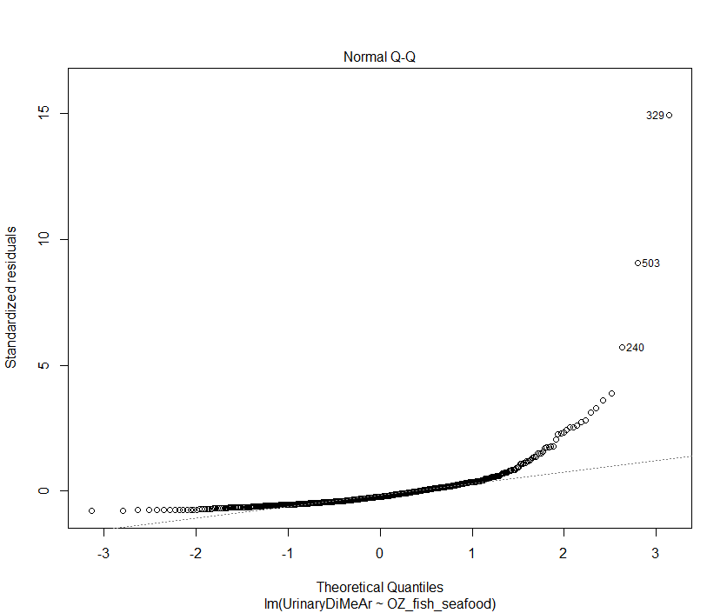
Seafood vs. dimethyl arsenic linear regression

Slide 20
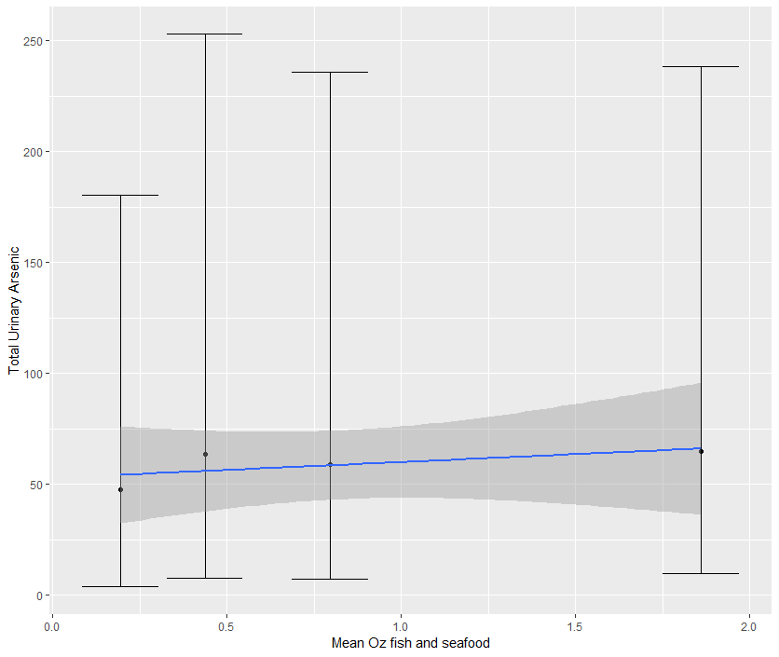
Seafood vs. arsenic binned

Slide 21
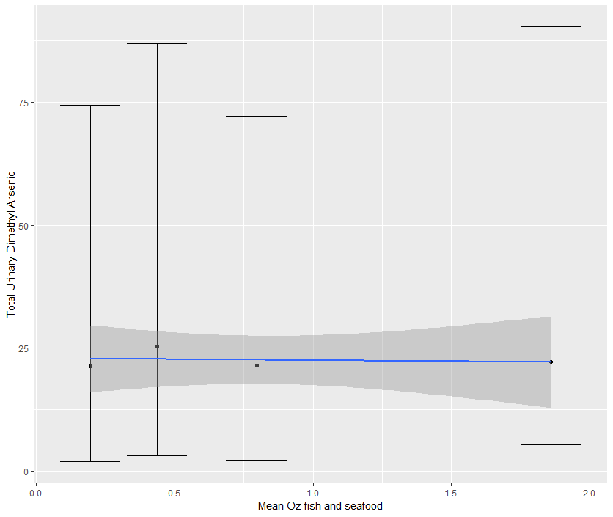
Seafood vs. dimethyl arsenic binned

Slide 22
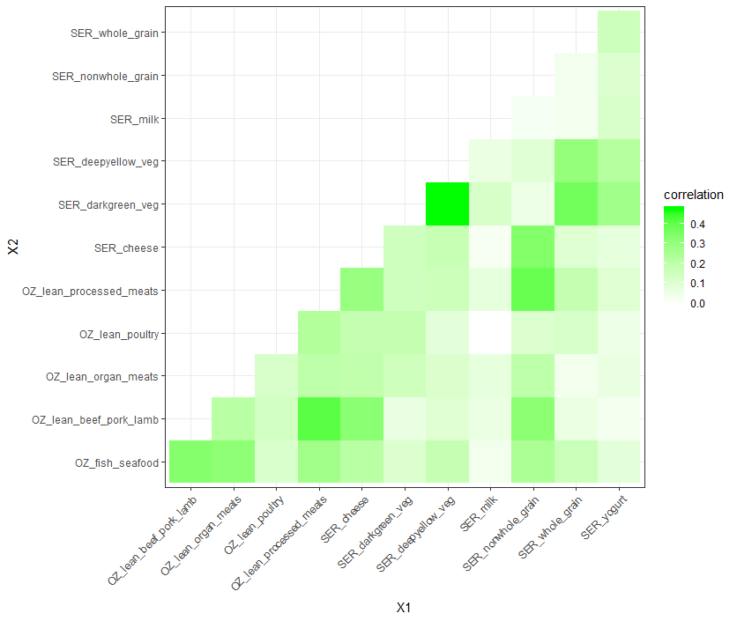
Not much in the way of correlation between most dietary vars, esp. ones associated with urinary arsenic species

Slide 23

Monte Carlo Simulation framework
The mass balance framework leads us to expect that if all sources of arsenic are accounted for, $ℰ≅𝒟$, where $ℰ$ is a measure of arsenic excretion and $𝒟$ is a measure of recent arsenic intake
Therefore, regressing a measure of $ℰ$ on a measure$\hat{𝒟}$may be used to infer whether sources of arsenic are adequately accounted for in $\hat{𝒟}$

Slide 24
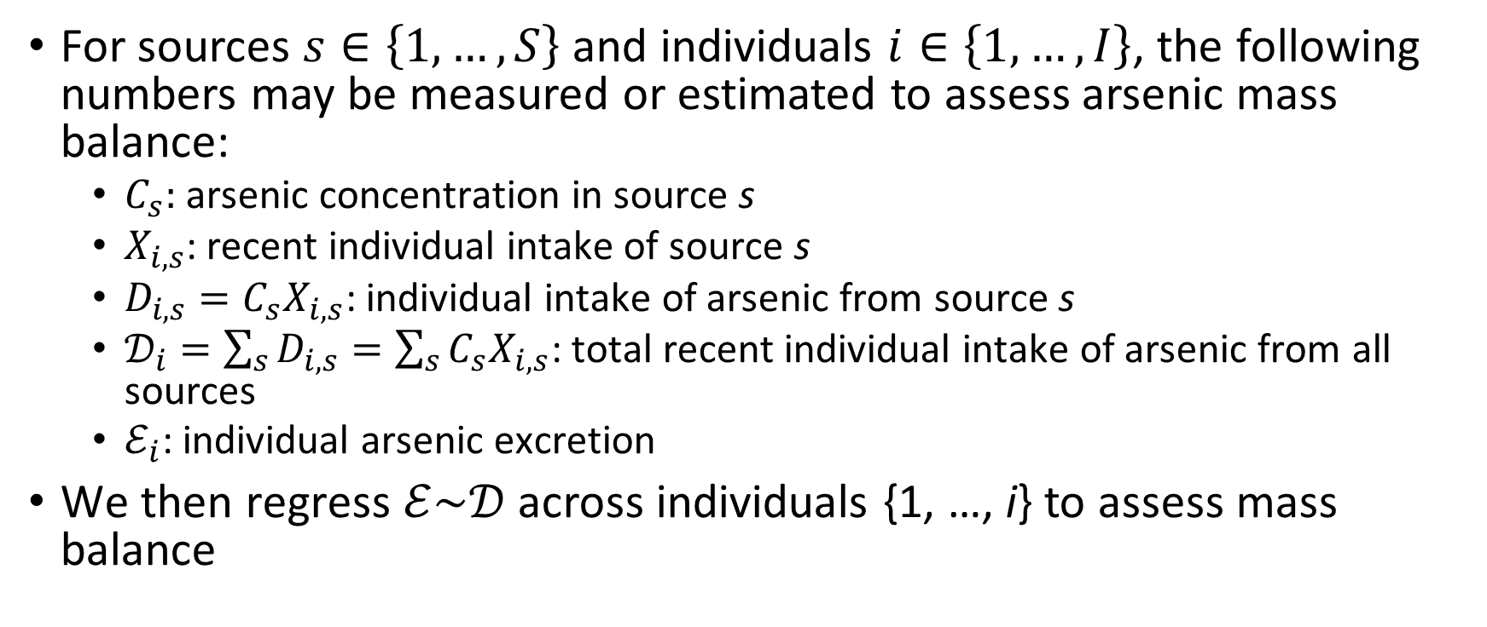
Monte Carlo Simulation framework
For sources $s∈\left\{1,…,S\right\}$ and individuals $i∈\left\{1,…,I\right\}$, the following numbers may be measured or estimated to assess arsenic mass balance:
$C_{s}:$ arsenic concentration in source s
$X_{i,s}$: recent individual intake of source s
$D_{i,s}=C_{s}X_{i,s}$: individual intake of arsenic from source s
$𝒟_{i}=\sum_{s}{D_{i,s}=\sum_{s}{C_{s}X_{i,s}}}$: total recent individual intake of arsenic from all sources
$ℰ_{i}$: individual arsenic excretion
We then regress $ℰ\sim 𝒟$ across individuals {1, …, i} to assess mass balance

Slide 25
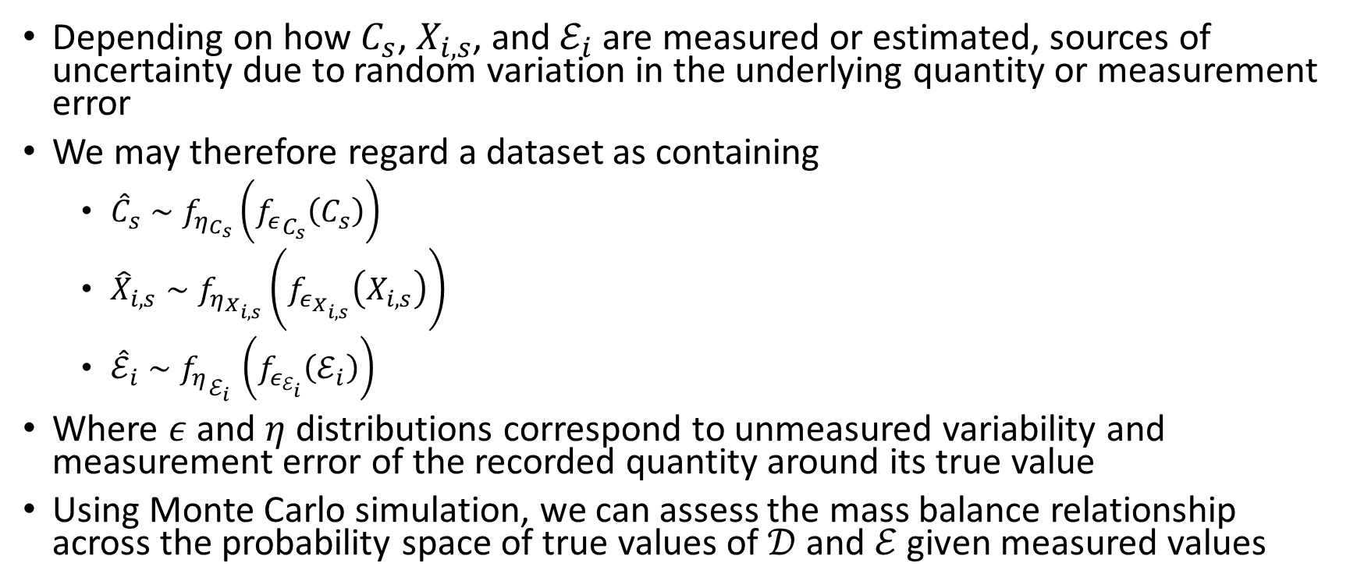
Monte Carlo Simulation framework
Depending on how $C_{s}$, $X_{i,s}$, and $ℰ_{i}$ are measured or estimated, sources of uncertainty due to random variation in the underlying quantity or measurement error
We may therefore regard a dataset as containing
${\hat{C}}_{s}∼f_{η_{C_{s}}}\left({f_{ε}}_{C_{s}}\left(C_{s}\right)\right)$
${\hat{X}}_{i,s}∼f_{η_{X_{i,s}}}\left(f_{ε_{X_{i,s}}}\left(X_{i,s}\right)\right)$
${\hat{ℰ}}_{i}∼{f_{η}}_{ℰ_{i} }\left(f_{ε_{ℰ_{i}}}\left(ℰ_{i}\right)\right)$
Where $ε$ and $η$ distributions correspond to unmeasured variability and measurement error of the recorded quantity around its true value
Using Monte Carlo simulation, we can assess the mass balance relationship across the probability space of true values of $𝒟$ and $ℰ$ given measured values

Slide 26
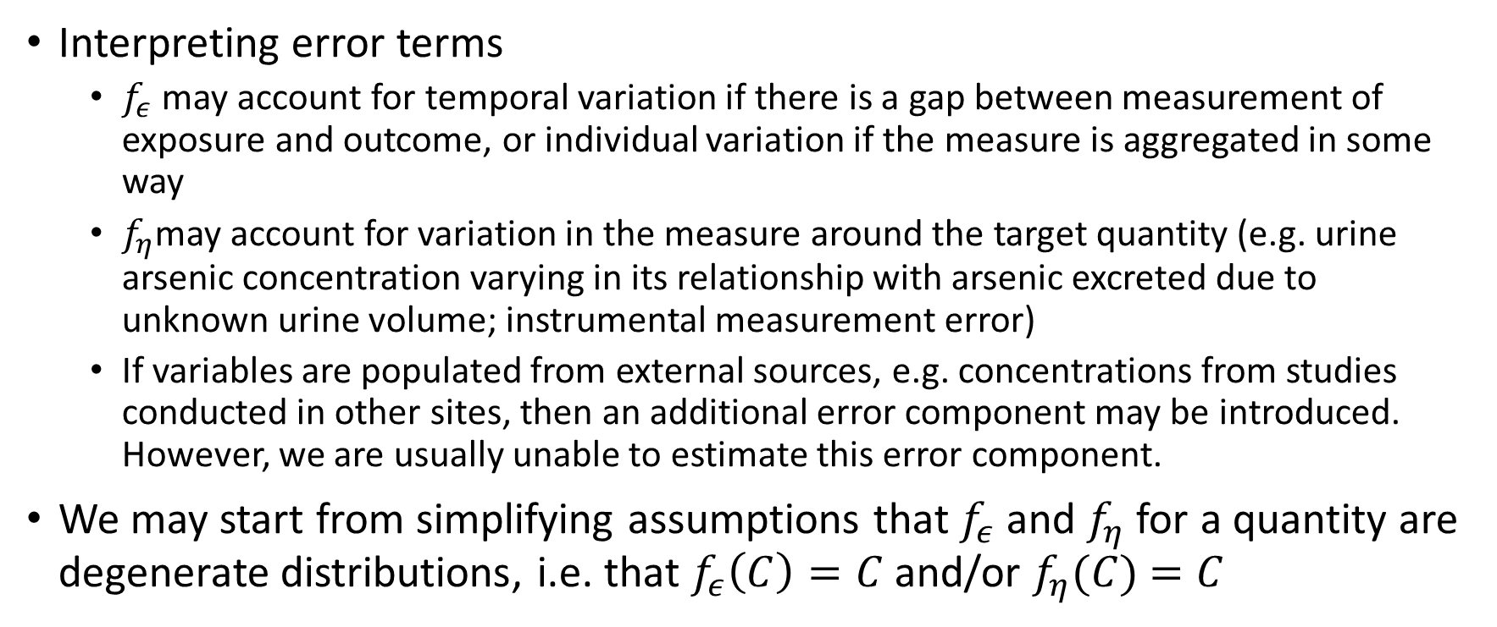
Monte Carlo Simulation framework
Interpreting error terms
$f_{ε}$ may account for temporal variation if there is a gap between measurement of exposure and outcome, or individual variation if the measure is aggregated in some way
$f_{η}$may account for variation in the measure around the target quantity (e.g. urine arsenic concentration varying in its relationship with arsenic excreted due to unknown urine volume; instrumental measurement error)
If variables are populated from external sources, e.g. concentrations from studies conducted in other sites, then an additional error component may be introduced. However, we are usually unable to estimate this error component.
We may start from simplifying assumptions that $f_{ε}$ and $f_{η}$for a quantity are degenerate distributions, i.e. that $f_{ε}\left(C\right)=C$ and/or $f_{η}(C)$ $=C$

Slide 27
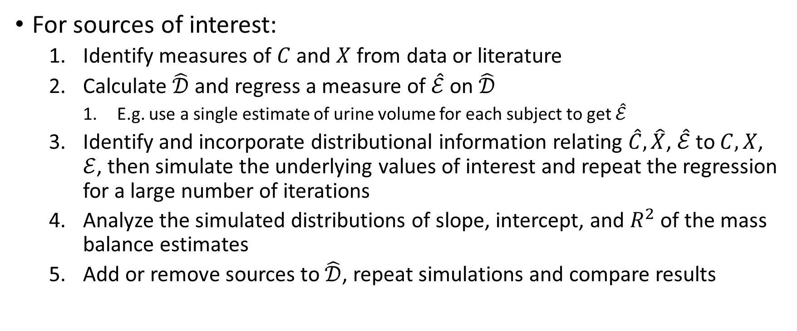
Proposed workflow
For sources of interest:
Identify measures of $C$ and $X$ from data or literature
Calculate $\hat{𝒟}$ and regress a measure of $\hat{ℰ}$ on $\hat{𝒟}$
E.g. use a single estimate of urine volume for each subject to get $\hat{ℰ}$
Identify and incorporate distributional information relating $\hat{C},\hat{X}$, $\hat{ℰ}$ to $C,X$, $ℰ$, then simulate the underlying values of interest and repeat the regression for a large number of iterations
Analyze the simulated distributions of slope, intercept, and $R^{2}$ of the mass balance estimates
Add or remove sources to $\hat{𝒟}$, repeat simulations and compare results

Slide 28
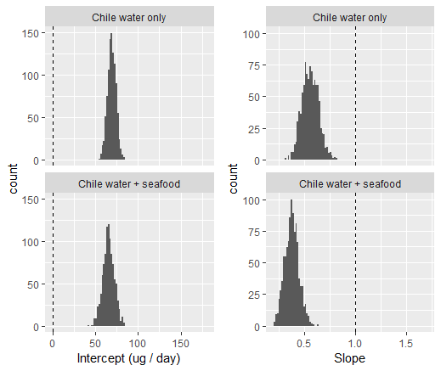
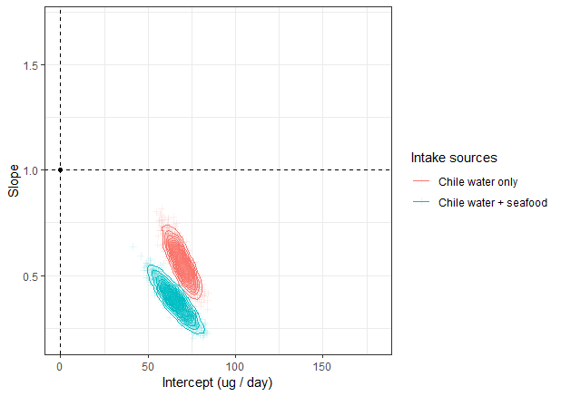

Slide 29


Slide 30
Missing sources + Systematic underestimate of excretion or overestimate of intake
Systematic underestimate of excretion or Overestimate of intake
Missing sources
Exposure misclassification or noisy excretion estimates

Slide 31

Missing sources + systematic underestimate of excretion or overestimate of intake
Systematic underestimate of excretion or overestimate of intake
Missing sources
Exposure misclassification or noisy excretion measures

Slide 32


Slide 33


Slide 34



